Slide 1
Code Generation

Slide 2
Code Generation
The code generation problem is the task of mapping intermediate code to machine code.
Requirements:
Correctness
Must preserve semantic meaning of source program
Efficiency
Make effective use of available resources
Code Generator itself must run efficiently

Slide 3
Input to the Code Generator
We assume, front end has
Scanned, parsed and translate the source program into a reasonably detailed intermediate representations
Type checking, type conversion and obvious semantic errors have already been detected
Symbol table is able to provide run-time address of the data objects
Intermediate representations may be
Postfix notations
Three address representations
Syntax tree
DAG

Slide 4
Target Programs
The output of the code generator is the target program.
Target architecture: must be well understood
Significantly influences the difficulty of code generation
RISC, CISC
Target program may be
Absolute machine language
It can be placed in a fixed location of memory and immediately executed
Re-locatable machine language
Subprograms to be compiled separately
A set of re-locatable object modules can be linked together and loaded for execution by a linker

Slide 5
Issues in the Design of a Code Generator
Instruction Selection
Register Allocation
Evaluation Order

Slide 6
Instruction Selection
There may be a large number of ‘candidate’ machine instructions for a given IR instruction
Level of IR
High: Each IR translates into many machine instructions
Low: Reflects many low-level details of machine
Nature of the instruction set
Uniformity and completeness
Each has own cost and constraints
Accurate cost information is difficult to obtain
Cost may be influenced by surrounding context

Slide 7
Instruction Selection
For each type of three-address statement, a code skeleton can be designed that outlines the target code to be generated for that construct.
Say, x := y + z
Mov y, R0
Add z, R0
Mov R0, x
Statement by statement code generation often produces poor code

Slide 8
Instruction Selection
a := b + c
d := a + e
MOV b, R0
ADD c, R0
MOV R0, a
MOV a, R0
ADD e, R0
MOV R0, d
MOV R0, a
If a is subsequently used
MOV a, R0

Slide 9
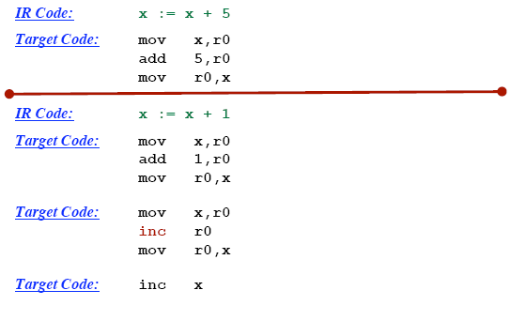
Instruction selection: Machine Idioms

Slide 10
Register Allocation
How to best use the bounded number of registers.
Use or registers
Register allocation
We select a set of variables that will reside in registers at each point in the program
Register assignment
We pick the specific register that a variable will reside in.
Complications:
special purpose registers
operators requiring multiple registers.
Optimal assignment is NP-complete

Slide 11
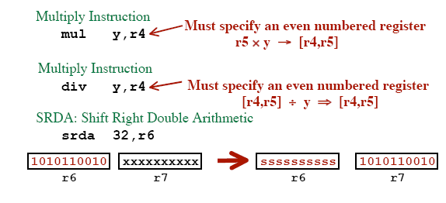
Register Allocation
r4

Slide 12
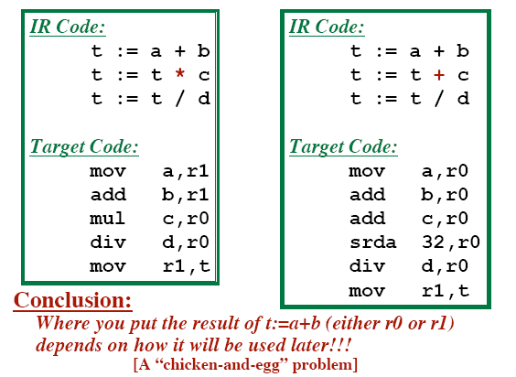
Register Allocation

Slide 13
Evaluation Order
Choosing the order of instructions to best utilize resources
Picking the optimal order is NP-complete problem
Simplest Approach
Don’t mess with re-ordering.
Target code will perform all operations in the same order as the IR code
Trickier Approach
Consider re-ordering operations
May produce better code
... Get operands into registers just before they are needed
... May use registers more efficiently

Slide 14
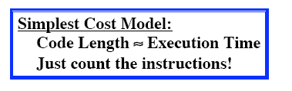
Evaluating A Potential Code Sequence
Each instruction has a “cost”
Cost = Execution Time
Execution Time is difficult to predict.
Pipelining, Branches, Delay Slots, etc.
Goal: Approximate the real cost
A “Cost Model”

Slide 15
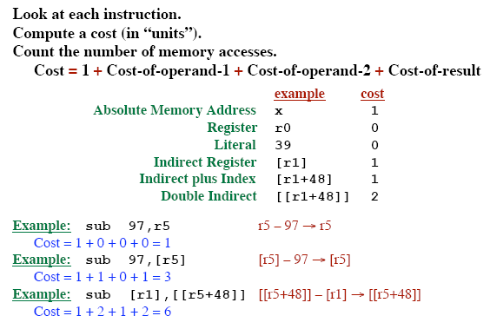
A Better Cost Model

Slide 16
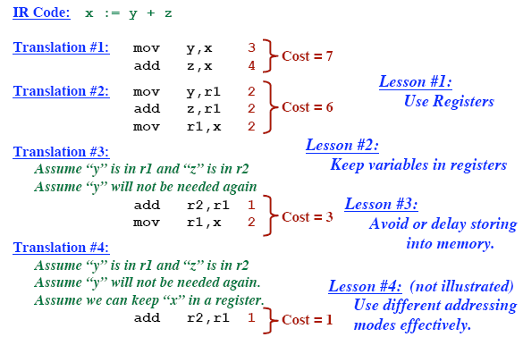
Cost Generation Example

Slide 17
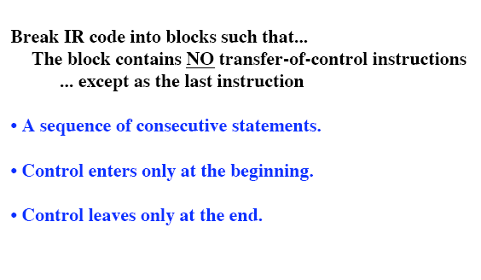
Basic Blocks

Slide 18
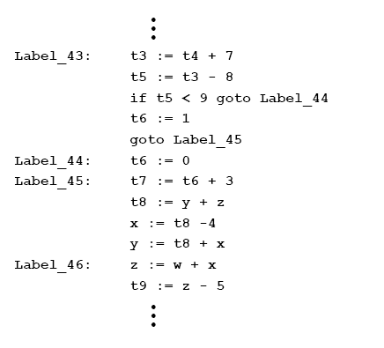
Basic Blocks

Slide 19
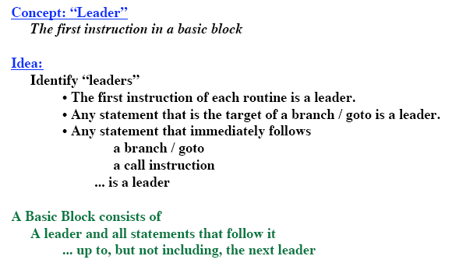
Algorithm to Partition Instructions into Basic Blocks

Slide 20
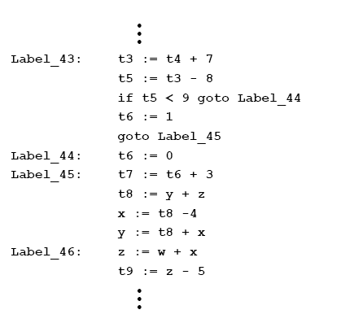
Identify Leaders – Example 1:

Slide 21
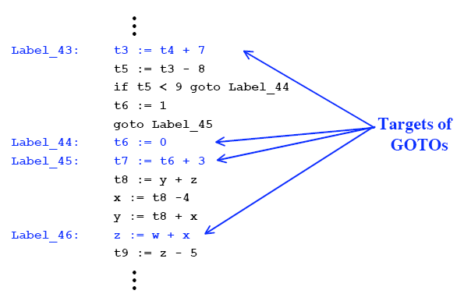
Identify Leaders – Example 1:

Slide 22
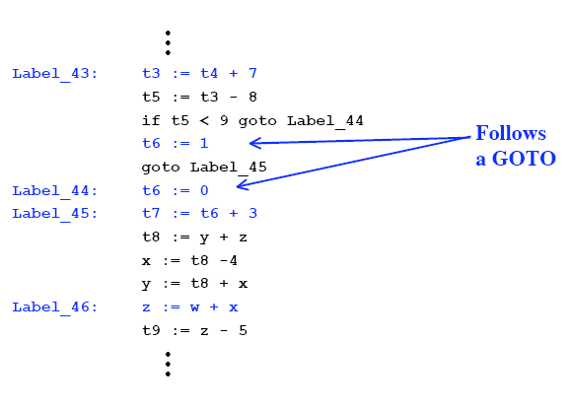
Identify Leaders – Example 1:

Slide 23
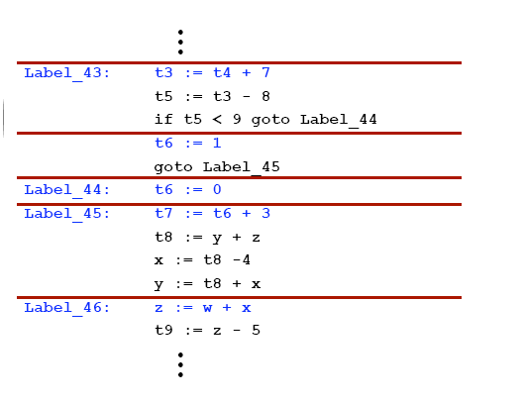
Identify Leaders

Slide 24
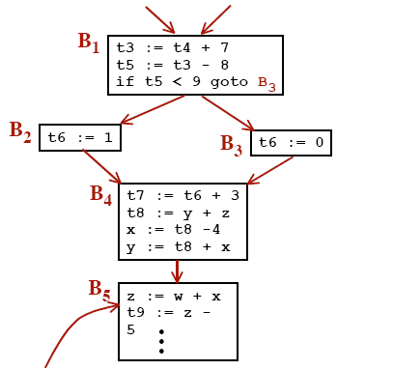
Control Flow Graph

Slide 25
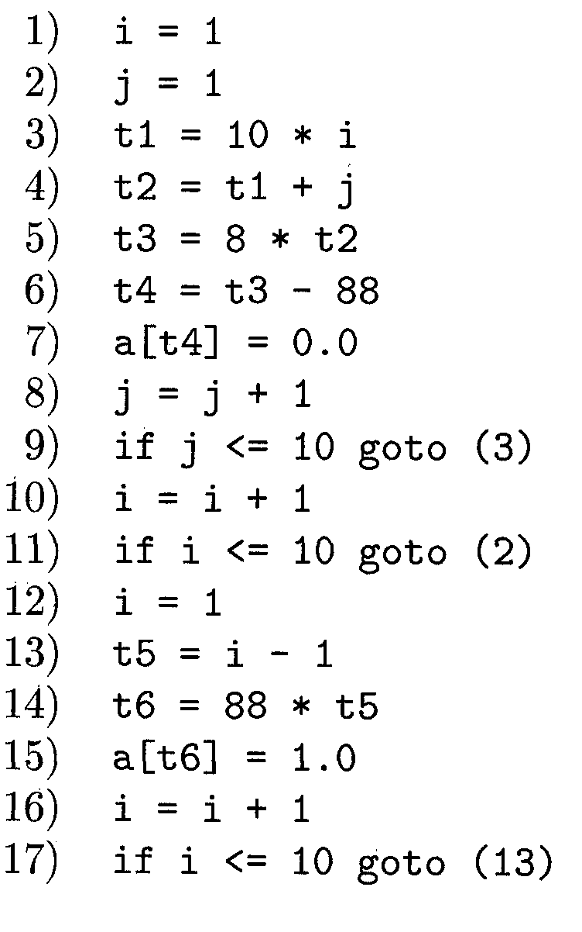
Identify Leaders – Example 2:

Slide 26
Identify Leaders – Example 2:
According to rule 1 : 1
According to rule 2 : 3, 2, 13
According to rule 3 : 10, 12

Slide 27
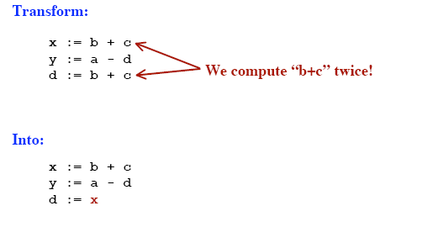
Common Sub-Expression Elimination

Slide 28
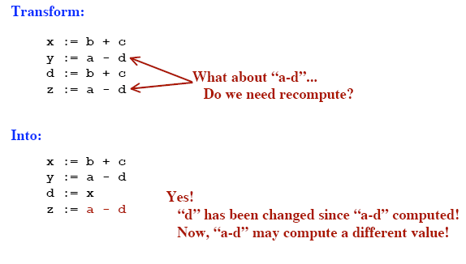
Common Sub-Expression Elimination

Slide 29
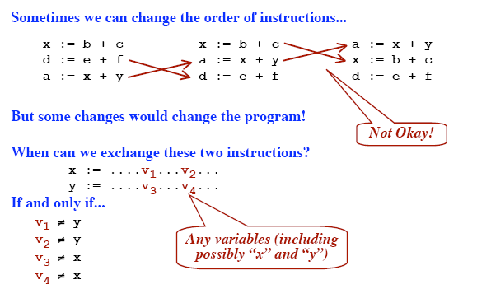
Reordering Instructions in a Basic Block

Slide 30
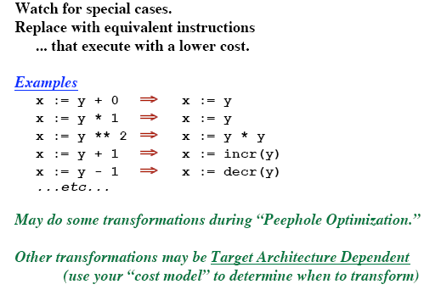
Algebraic Transformation

Slide 31
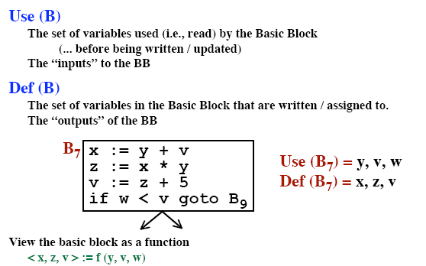
Look at Each Basic Block in Isolation

Slide 32
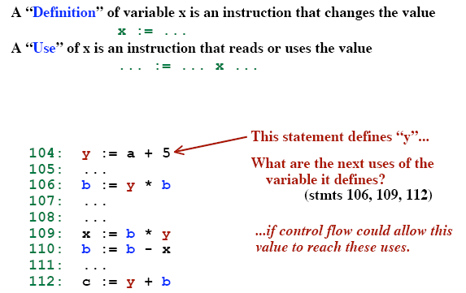
Definition and Use of variables

Slide 33
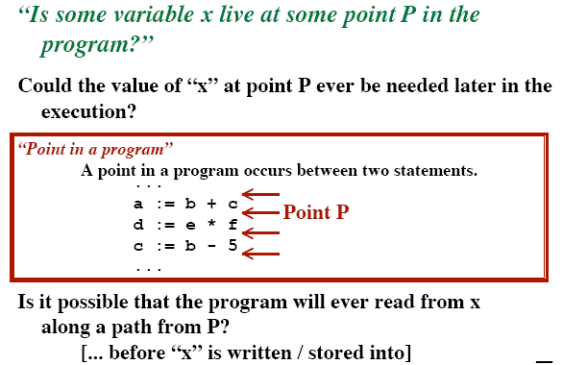
Live Variables

Slide 34
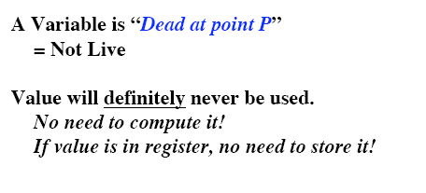
Dead Variables

Slide 35
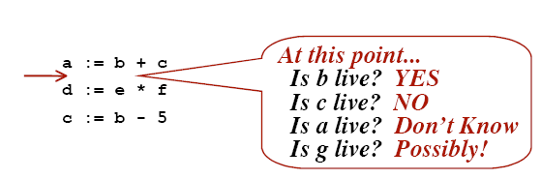
Liveness Example

Slide 36
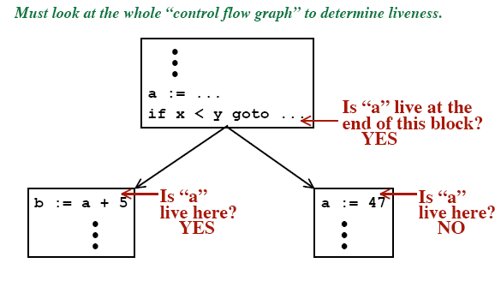
Liveness Example

Slide 37
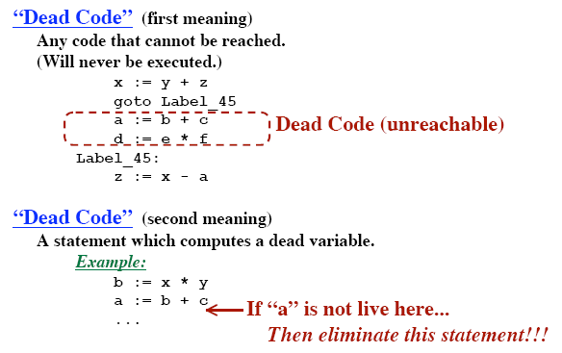
Dead Code

Slide 38
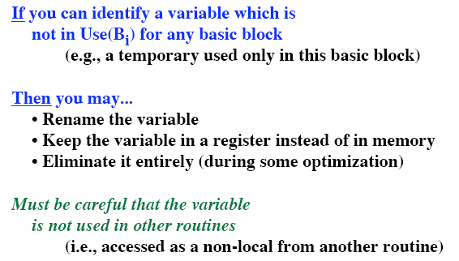
Temporaries

Slide 39
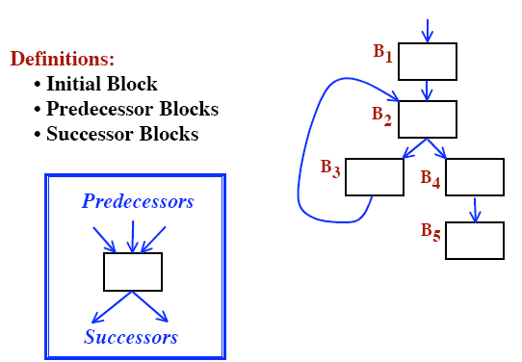
Control Flow Graphs

Slide 40
Machine-Independent Optimizations

Slide 41
Code optimization
Elimination of unnecessary instructions
Replacement of one sequence of instructions by a faster sequence of instructions
Local optimization
Global optimizations
based on data flow analyses

Slide 42
Introduction
Organization of an optimizing compiler
Control flow analysis
Data flow analysis
Transformation
Code optimizer

Slide 43
Themes behind Optimization Techniques
Avoid redundancy: something already computed need not be computed again
Smaller code: less work for CPU, cache, and memory!
Less jumps: jumps interfere with code pre-fetch
Code locality: codes executed close together in time is generated close together in memory – increase locality of reference
Extract more information about code: More info – better code generation

Slide 44
Semantics-Preserving Transformations
A number of ways in which a compiler can improve a program without changing the function it computes
Common-sub expression elimination
Copy propagation
Dead-code elimination
Constant folding

Slide 45
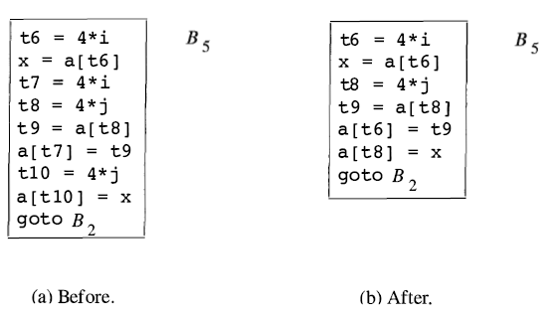
Common Subexpressions
Common subexpression
Previously computed
The values of the variables not changed
Local:

Slide 46
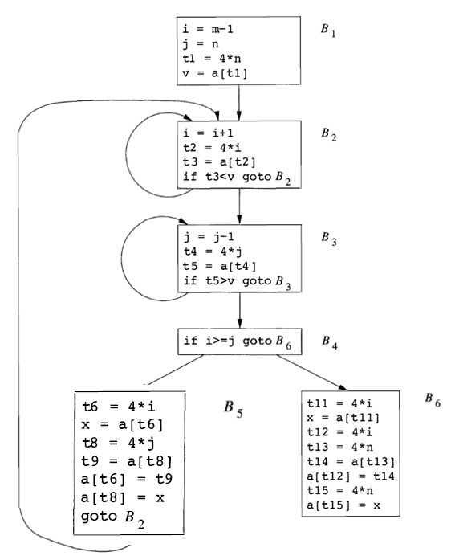
Common Subexpressions
Global
Notes:
Any other common subexpression?

Slide 47
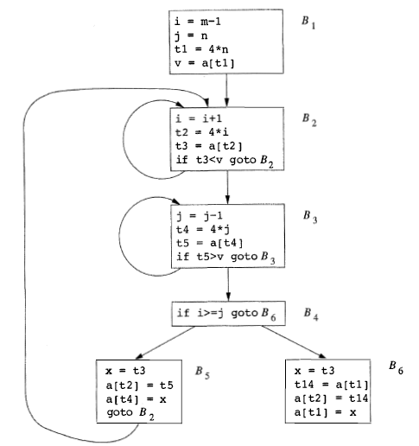
Notes:
Are a[t1] in B1 and in B6 common subexpression?

Slide 48
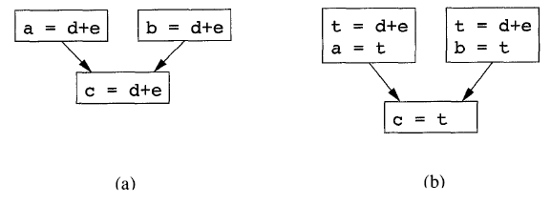
Copy Propagation
Copy statements or Copies
u = v
Notes:
a图中：为了消除d+e，需要引入t变量，并产生a=t,b=t,以及c=t,如图b
但是我们不应该用c=a，或者c=b，因为不一定走a还是b
当有u=v赋值时，后面究竟用v还是u，应该用v，因为可能可以消除u=v

Slide 49
Dead-Code Elimination
Live variable
A variable is live at a point in a program if its value can be used subsequently;
otherwise, it is dead at that point.
Constant folding
Deducing at compile time that the value of an expression is a constant and using the constant instead

Slide 50
Code Motion
Moving code from one part of the program to other without modifying the algorithm
Reduce size of the program
Reduce execution frequency of the code subjected to movement

Slide 51
Dead Code Elimination
int foo(void) {
int a = 24; int b = 25; /* Assignment to dead variable */
int c;
c = a * 4;
return c;
b = 24; /* Unreachable code */
return 0;
}

Slide 52
Code Motion
Code Space reduction: Similar to common sub-expression elimination but with the objective to reduce code size.
Example: Code hoisting
temp : = x ** 2
if (a< b) then if (a< b) then
z := x ** 2 z := temp
else else
y := x ** 2 + 10 y := temp + 10
“x ** 2“ is computed once in both cases, but the code size in the second case reduces.

Slide 53
Code Motion
Execution frequency reduction: reduce execution frequency of partially available expressions (expressions available atleast in one path)
Example:
if (a<b) then if (a<b) then
z = x * 2 temp = x * 2
z = temp
else else
y = 10 y = 10
temp = x * 2
g = x * 2 g = temp;

Slide 54
Code Motion
Move expression out of a loop if the evaluation does not change inside the loop.
Example:
while ( i < (max-2) ) …
Equivalent to:
t := max - 2
while ( i < t ) …

Slide 55
Redundant instruction elimination
Redundant load/store: see if an obvious replacement is possible
MOV R0, a MOV a, R0
Can eliminate the second instruction without needing any global knowledge of a
Unreachable code: identify code which will never be executed:
#define DEBUG 0
if( DEBUG) { if (0 != 1) goto L2
print debugging info print debugging info
}
L2:

Slide 56
Algebraic identities
Worth recognizing single instructions with a constant operand:
A * 1 = A
A * 0 = 0
A / 1 = A
A * 2 = A + A
More delicate with floating-point
Strength reduction:
A ^ 2 = A * A

Slide 57
Replace Multiply by Shift
A := A * 4;
Can be replaced by 2-bit left shift (signed/unsigned)
But must worry about overflow if language does
A := A / 4;
If unsigned, can replace with shift right
But shift right arithmetic is a well-known problem
Language may allow it anyway (traditional C)

Slide 58
Usage of Machine idioms
Use machine specific hardware instruction which may be less costly.
i := i + 1
ADD i, #1 INC i

